Slide 1

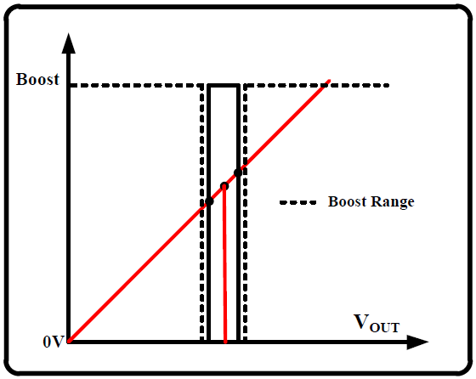
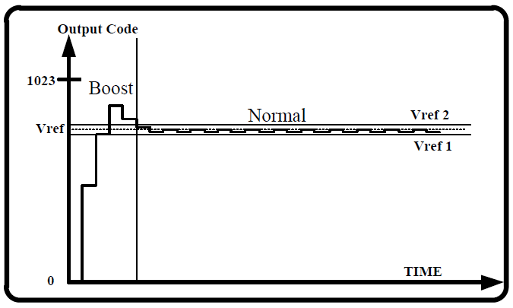
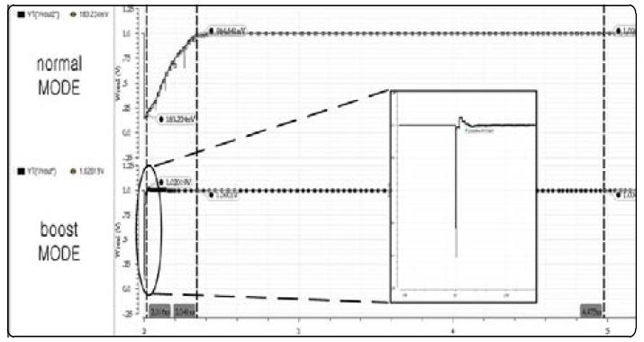
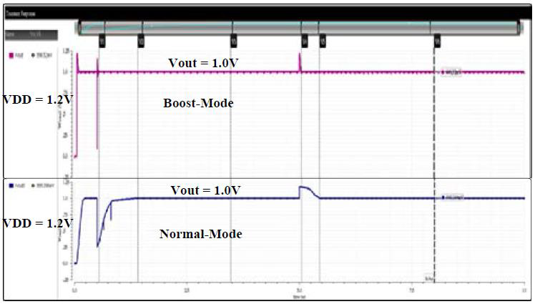
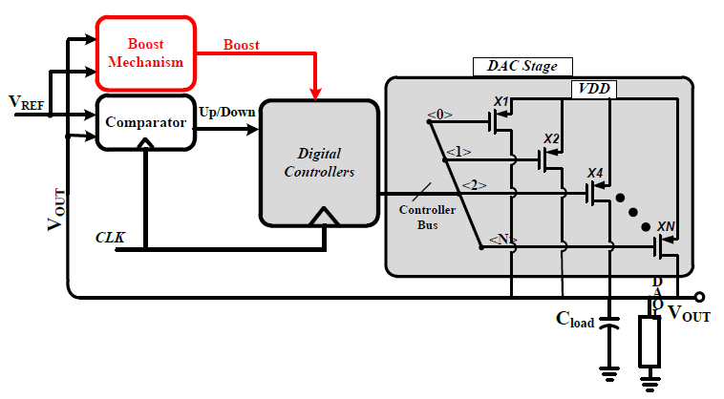
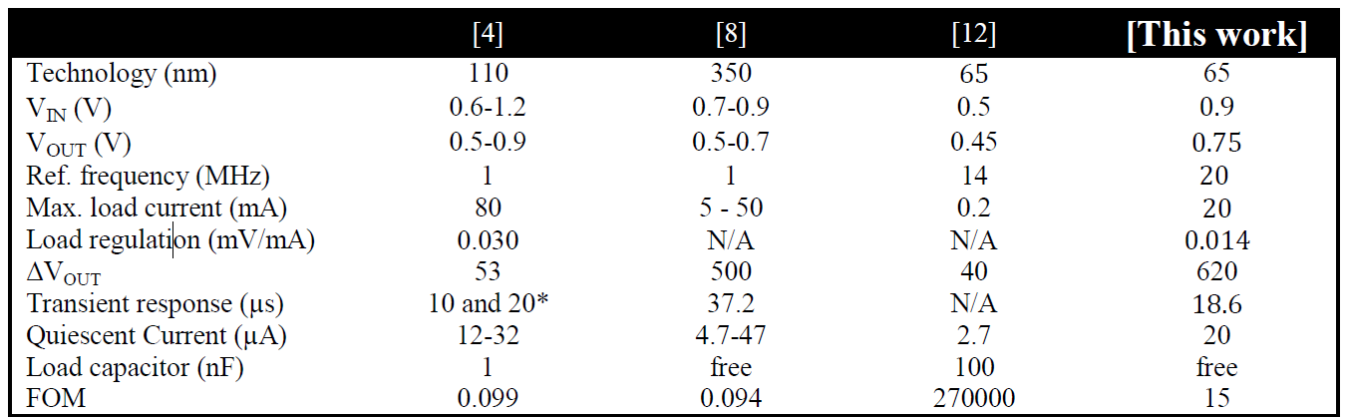
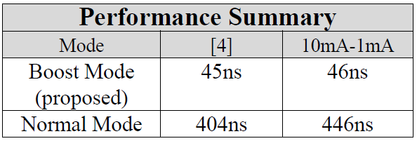
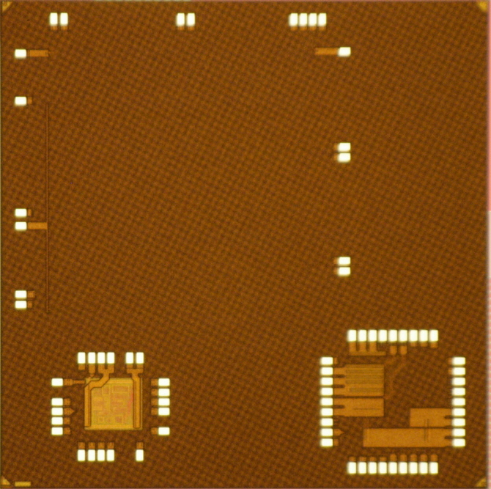

A fast transient digital-LDO using Boost Mode with 99.9%
current efficiency
Jun-Sik Choi, Muhammad Abrar Akram and In-Chul Hwang
Intelliegent Circuits and Systems Laboratory
Department of Electrical and Electronics Engineering
Kangwon National University, Chuncheon, Korea
1. Abstract
Jul 2022
This paper presents a fully digital, current efficient and fast transient response digital low drop-out regulator to be used in multi-voltage domains levels for on chip delivery networks. A boost mechanism is embedded with the normal loop of operation which achieves the fast transient response in current transients. The structure reveals the efficient load regulation with the reduced ripple effects. The proposed structure is designed in samung-65nm CMOS process. The simulated response shows the transient response of 45ns with 10mA of load current. With this condition, it achieves the peak current efficiency of 99.9%. The design parameters of proposed digital-LDO are supply voltage 1.2V, maximum operating frequency 20MHz, complete digital architecture.
Fig. 2 shows the activation scheme of boost mechanism. The boost mechanism is embedded with a pre-defined range of lock region. This range is embedded by varying the size ratios of PMOS/NMOS switches. As by varying the aspect ratios the operating region can be expanded or contracted.
Two types of controllers provide the two modes of control: fine control and coarse control. In fine control the conventional accumulator performs the iterations to generate the 12-bit digital code until the target voltage is achieved. The conventional accumulator is based on integral base and it counts on every clock cycle and provides the efficient load regulation and enhanced ripple performance. This is normal mode of operation. On the other hand the coarse control is activated for just transient time to perform the target recovery from large droops/overshoots. SAR controller provides boost mode by varying the loop gain. The drawn response of SAR and conventional accumulator is shown in Fig. 3.
Fig. 2 Boost mechanism activation range
Fig. 3 The overall response of proposed LDO
2. Motivation & Problem Statement
In modern SoC designs, distributed low-dropout (LDO) regulators ar e extensively applied for precise and responsive on-chip power mana gement.
D-LDOs severely suffer from the trade-off issues between fast tran sient response and current efficiency.
Designing trends for linear regulators are changing from conventional analog LDO to digital, because in former approach good power efficiency can be achieved due to small quiescent current, but it causes very slow response, moreover digital world also diminishes the external components used for compensation issues like in analog.
5. Simulations and Results
3. Proposed Fast-Transient & Current Efficient D-LDO
Fig. 4 Simulated transient response
for no load condition.
Fig. 5 Simulated transient response
for step load current of 10mA
The proposed digital-LDO is a digital structure and digital simulation, PEX and LPE simulations are being carried out for evaluation in Cadencetool version IC615 and caliber respectively. The transient response of the proposed digital is simulated for no load conditions and for both modes; normal mode and the boost mode as shown in Fig. 5.
Fig. 1 Block diagram of proposed digital-LDO
Fig. 1 illustrates the block diagram of proposed Digital LDO comprises of a comparator, which provides the level of voltage to the controller by comparing the reference voltage with the feed-back output voltage. Depending on the level of feed-back voltage comparator generates the up/down voltage which is high in the case of (VOUT < VREF́ )and vice versa. After getting the up/down signal from comparator, digital controller operation is started to perform successive approximations and it generates the 12-bit digital code to drive the switch array of power transistors until the target voltage equal to reference voltage is achieved. To accelerate this loop process a boost mechanism is proposed inside the loop which is activated for just transient response time. An approximation of boost range is applied which covers the minimum dropout voltage range, according to that any occurrence of overshoot/undershoot beyond this range is detected by the boost detector to take over the effect.
Table 1 : Performance summary and comparison with other architectures.
Table 2 : Characteristics of load transient
response for both modes.
Fig. 6 Chip die photo
“This work was supported by the Ministry of Education of the Republic of Korea and the National Research Foundation of Korea (NRF-2020R1I1A3073683)”
“This research was supported by the MSIT(Ministry of Science and ICT), Korea, under the ITRC(Information Technology Research Center) support program(IITP-2021-2018-0-01433) supervised by the IITP(Institute for Information & communications Technology Promotion)”
“The chip fabrication and EDA tool were supported by the IC Design Education Center(IDEC), Korea.”

